Slide 1
Book Cover Recognition using Local Features
Experimental Result
Phan Thi My Dung
Student ID: 127343
Advisor: Prof. Kim Soo Hyung

Slide 2
Content
Stanford Book Cover Dataset
Experimental Result

Slide 3
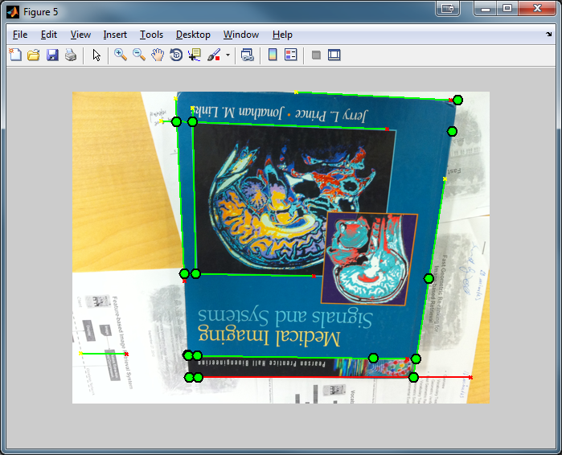
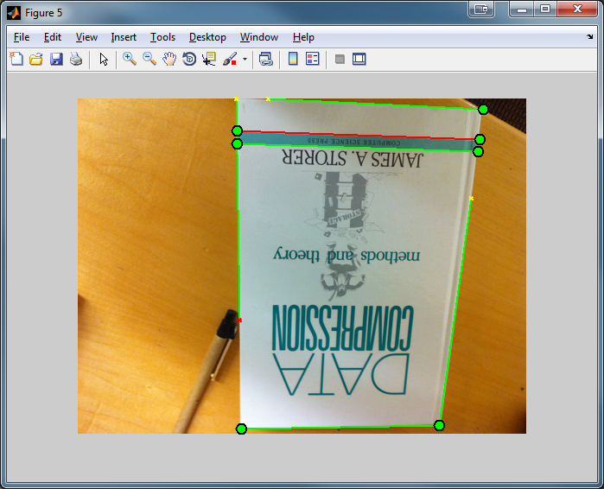
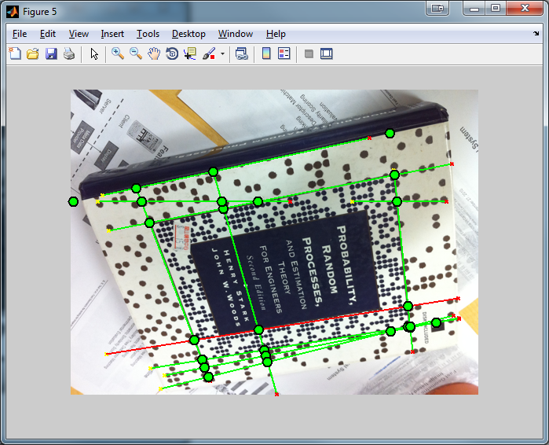
Segmentation Issues
Method
Extract edges in image.
Using Hough Transform to extract lines.
Issues:
Cannot detect all borders of book cover successfully.
-> It’s difficult to segment book cover out off background.
-> To solve later.

Slide 4
Stanford Book Dataset
Total number of images: 505
Training dataset: 101 images
Standard image obtains from product website.
Testing dataset: 404 images
Captured from several different mobile cameras and digital cameras.
Captured Image indoors under widely varying lighting conditions.
Images are included foreground and background clutter.
Reference: “The Stanford Mobile Visual Search Dataset”, V. Chandrasekhar, D. Chen, S. Tsai, N. Cheung, H. Chen, G. Takacs, Y. Reznik, R. Vedantham, R. Grzesczcuk, J. Bach, B. Girod, In Proceedings of the First ACM Multimedia Systems Conference (MMSys) San Jose, CA, USA, February 23-25, 2011

Slide 5
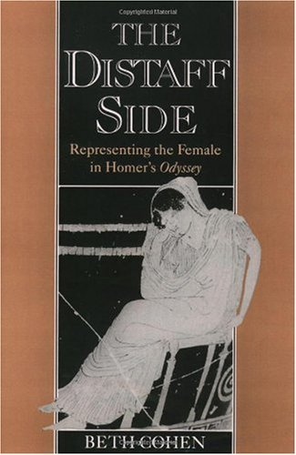
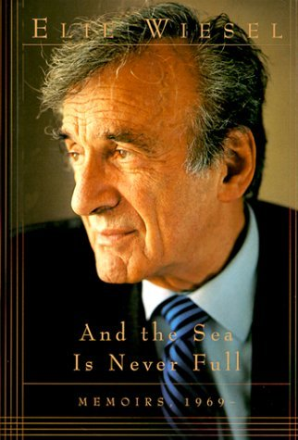

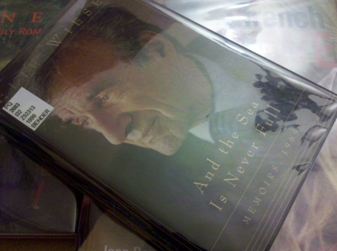
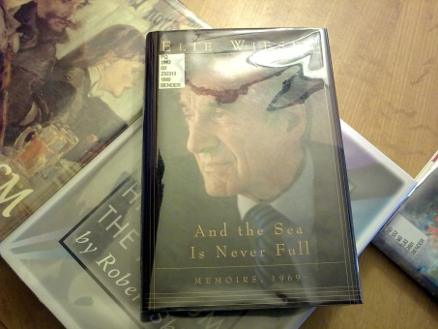
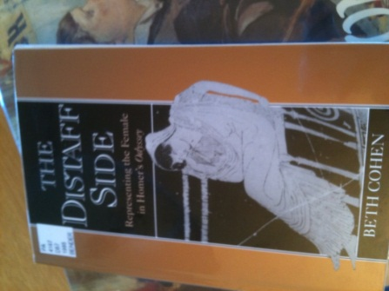
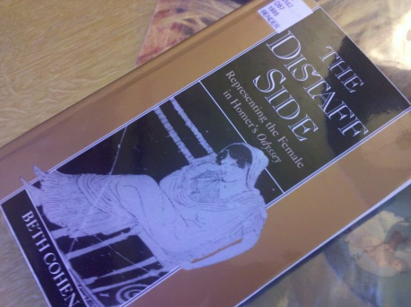
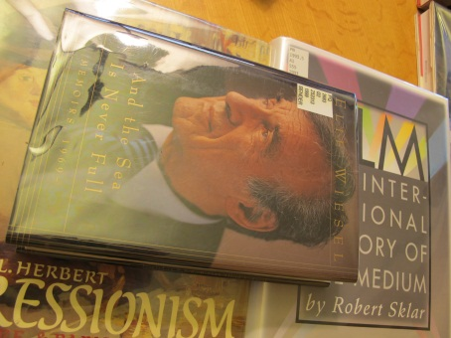
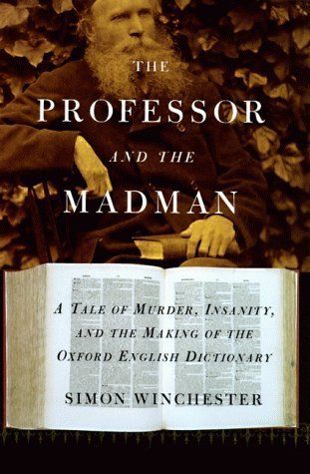
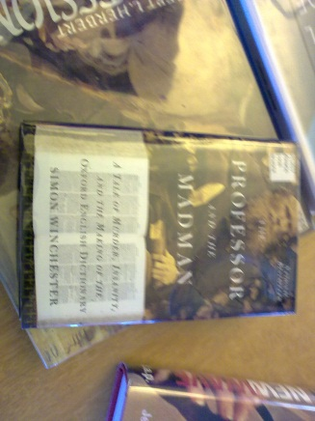
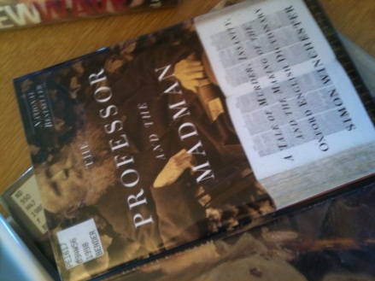
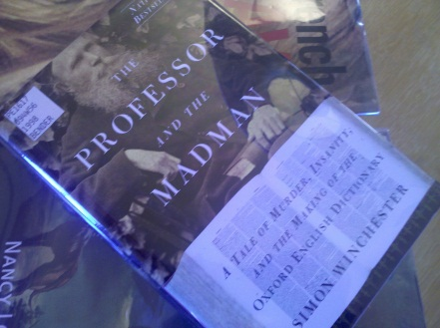
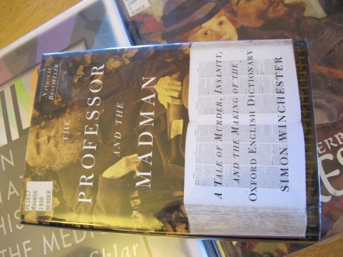

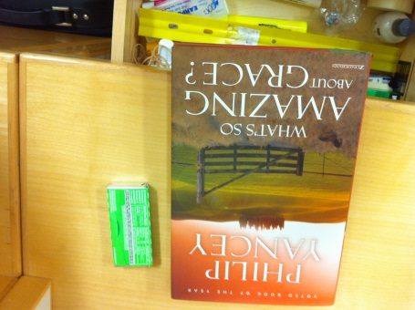



IPhone
Droid
Canon
5800
Notes:
Tmp: Total Accuracy: 99/101=98%
Total Failed: 2
Total Unknown: 0
Total Time Consuming: 375218ms
Press any key on image window ...

Slide 6
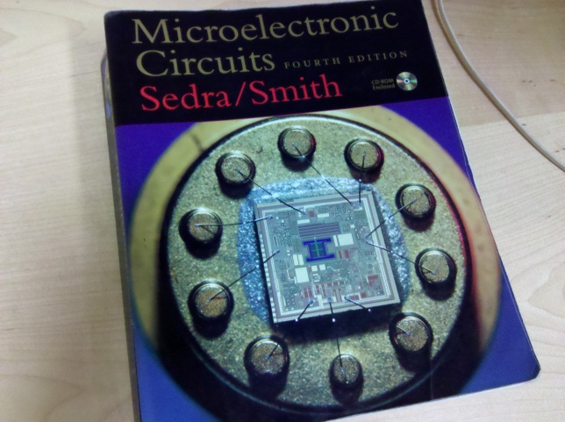
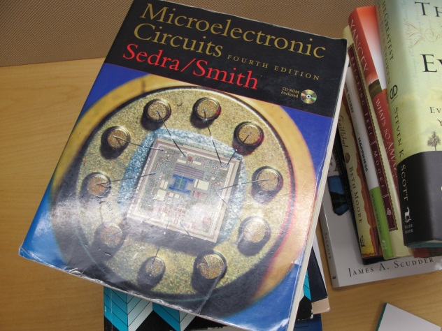
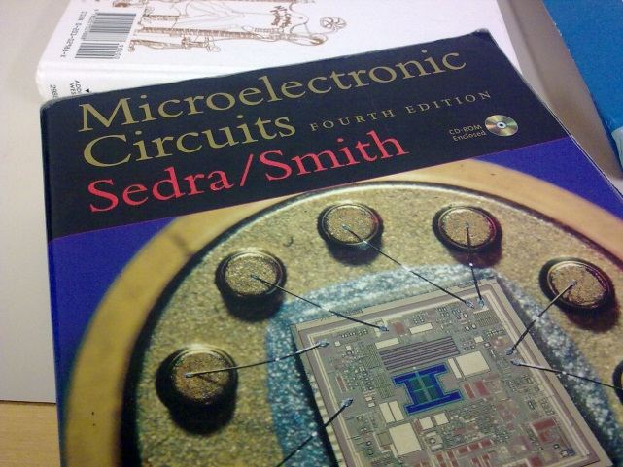
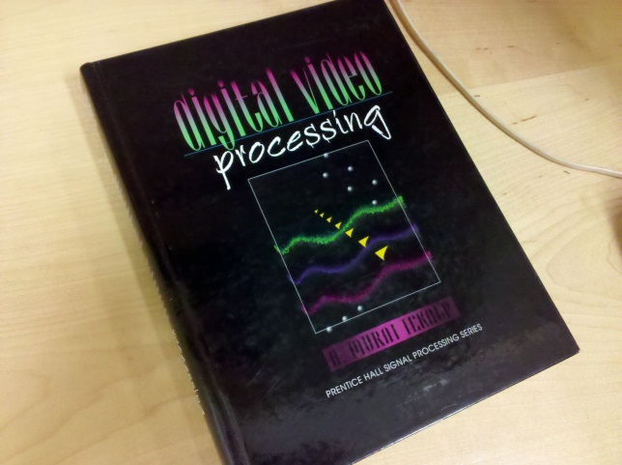
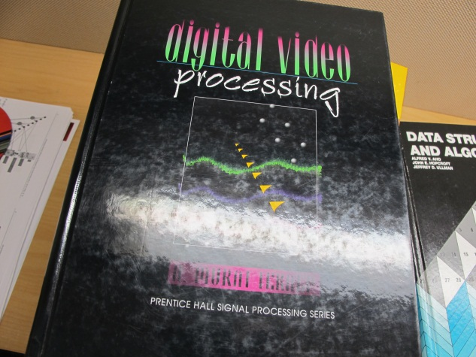
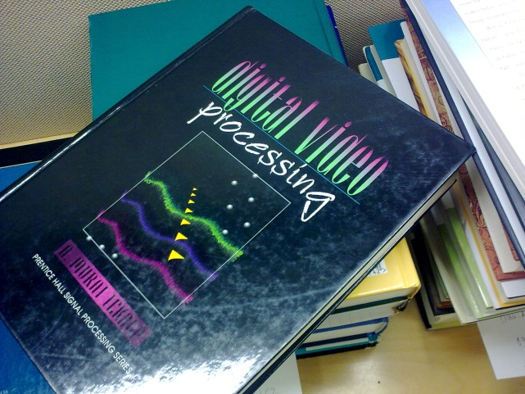
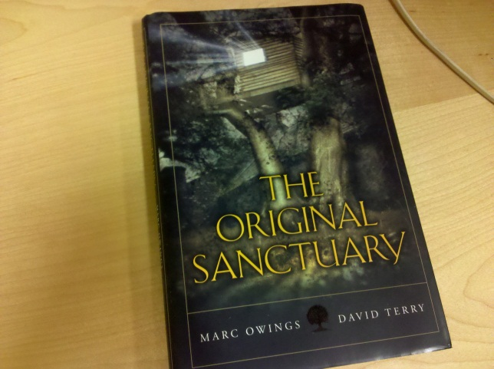



Slide 7
Experimental Result
SIFT features + Manhattan Metric + knn Matching
Accuracy: 98%
Total Processing Time: 12,620,217ms/404 query
12620s/404 = 31s/query
31s/101matching = 310ms/matching
Notes:
SIFT
Total Accuracy: 398/404=98%
Total Failed: 5%
Total Unknown: 1%
Total Time Consuming: 12,620,217ms

Slide 8
Experimental Result
ORB + FLANN + KNN + LSH
Iphone + Canon dataset
Using 500 features
Accuracy: 95%
Time: 4s/query -> 40ms/matching
Droid + 5800 dataset
Using 800 features
Accuracy: 90%
Time: 5s/query -> 50ms/matching

Slide 9
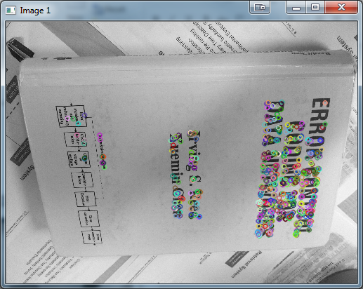
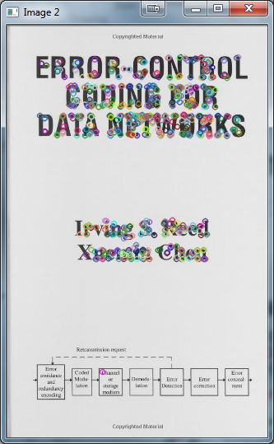
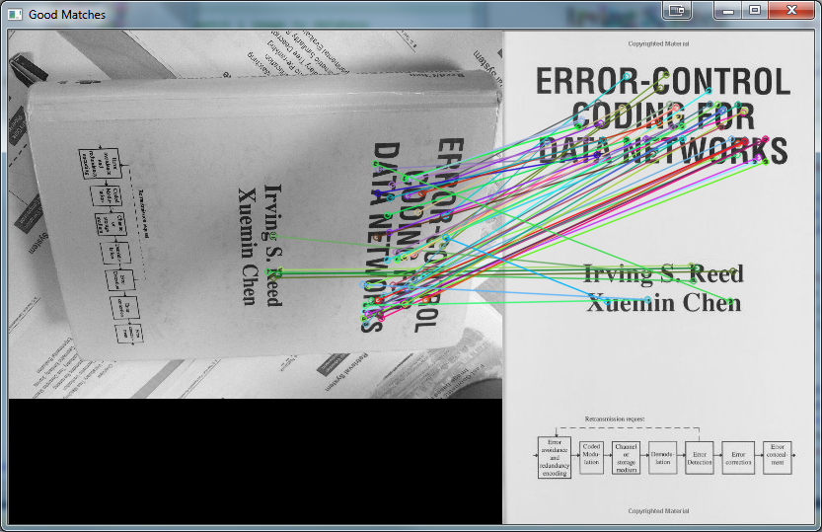

Slide 10
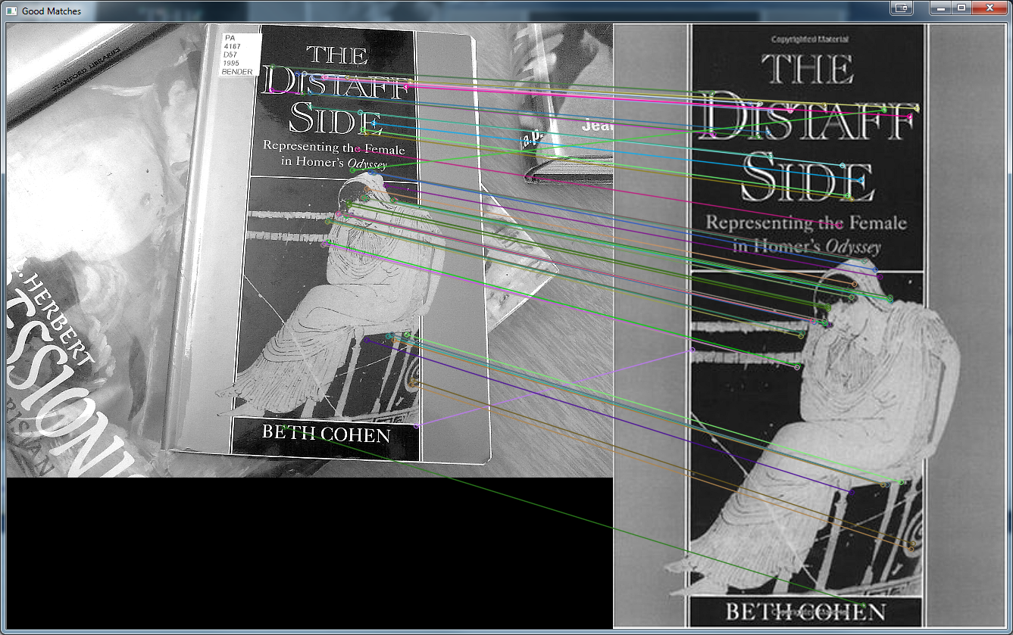

Slide 11
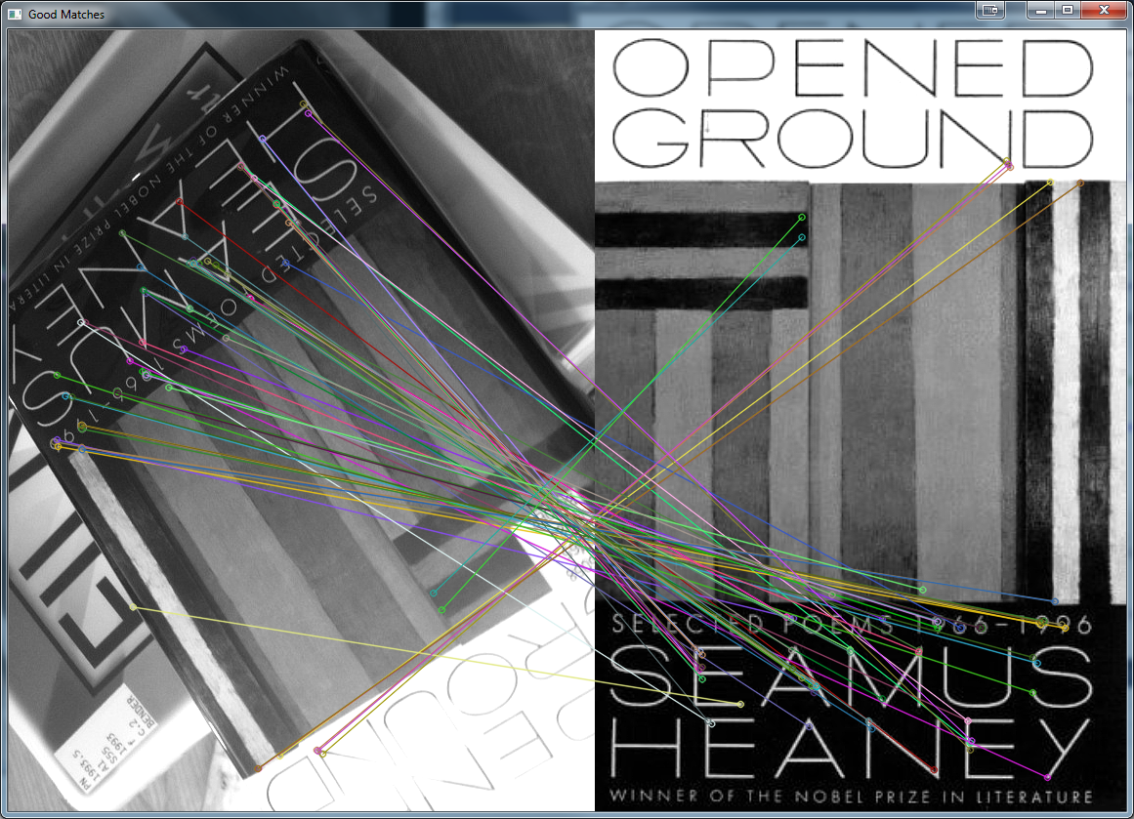

Slide 12
Conclusion
Improve time processing compare to SIFT.
But, accuracy is not good, to be improved more.
Future works
Enhance image before matching.
Need a good object segment.

Slide 13
Thanks for your attention!

